Slide 1

Lesson Two Electricity
The Harnessed Atom

Slide 2
What you need to know about Electricity:
Basics of electricity
Generating electricity
Using steam, turbines, generator
Similarities of power plants
Distributing Electricity
Generation
Transmission
Distribution
Power grid
Smart grid
Utilities
Cost of electricity
Regulation
Deregulation
Planning for the future

Slide 3
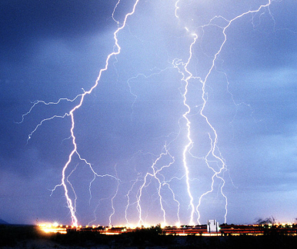
What is electricity?
Electricity is the flow of electrons.
Sometimes you see it in the sky in a lightning streak.
Sometimes you hear it crackle when you take off a sweater.
We make electricity flow through a wire to send it to where we need it.
One reason we use so much electricity is that it can be used in so many ways. We send it by wire into homes, schools, and workplaces to provide light, heat, cooling, and to run machines.
Notes:
Ask students: Is electricity a primary or secondary source of energy? (Answer: Secondary) Is coal a primary or secondary source? (Answer: Primary)
Ask students: Have you ever had to do without electricity for a while? What did you have to stop doing?

Slide 4
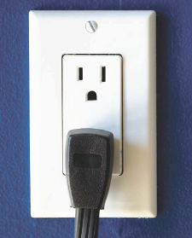
How is electricity produced?
In the United States, we convert energy from all these sources into electricity:
Fossil fuel (coal, natural gas, and oil)
Moving water (hydropower)
Uranium (nuclear power)
Wind, sunlight (solar power), biomass, geothermal heat, and even garbage.

Slide 5
Fuels used to make electricity in the United States, 2012
Check out how your State makes electricity: www.eia.doe.gov/state
Notes:
This pie chart shows percentages for how we use energy sources to produce electricity. Electricity comes from some of the same sources as our general energy pie chart in lesson 1. Compare this chart to it. Ask students: What is the biggest difference? (Petroleum and Coal: Petroleum is 37% of our overall energy consumption, but we only use it for 1% of our electricity generation. Most electricity is generated from coal.)
Ask students to consider
Are more fossil fuels forming now?
How much fuels cost now
What will happen to these costs as fuels grow more scarce
How they would like to see the mix of energy change, considering cost, environmental issues, risks, benefits, limits to our technology, and available supply for the future.

Slide 6
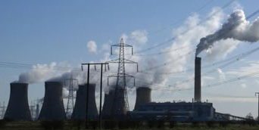
How does a fossil fuel power plant work?
Fossil fuels are burned to heat water to produce steam.
Steam turns the blades of a turbine.
The turbine spins a coil of wire on the shaft of a generator that turns inside a magnetic field.
Electrons flow in the coil…..That is electricity!
Video clip: Fossil fuel power station - how it works
http://www.youtube.com/watch?v=SeXG8K5_UvU
(courtesy of Nanticoke Generating Station)
Notes:
Show students how steam works. Boil water in a kettle. Let the steam turn a pinwheel. This activity is shown in the video Splitting Atoms , An Electrifying Experience. The video is on the DVD in the curriculum kit you received. Or your students could make pinwheels and try out the turbines themselves. A pinwheel lab is in the Teachers’ Guide.
The clip above runs about 2 minutes. Highlight the url with your cursor. Right click from your mouse to select “Open Hyperlink.”

Slide 7
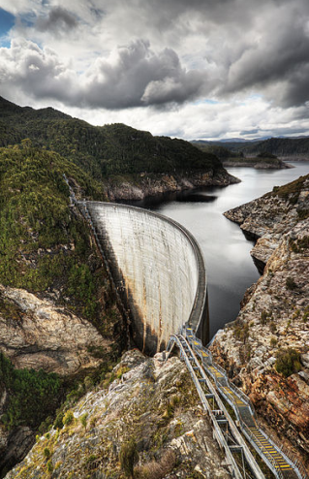
How does a hydroelectric power plant work?
Mechanical energy of moving water turns the blades of a turbine.
The turbine spins a coil of wire on the shaft of a generator that turns inside a magnetic field.
Electrons flow in the coil…..That is electricity!
Animated diagram: Hydroelectric power station - how it works
http://ga.water.usgs.gov/edu/hyhowworks.html
(courtesy of the Tennessee Valley Authority)
Notes:
Highlight the url with your cursor. Right click from your mouse to select “Open Hyperlink.” The link will take you to an animated clip of the hydroelectric dam. It also has a detailed hydroelectric generator illustration and a diagram to show how a reservoir is used to met fluctuations in energy demand.
Point out to students that you can see in this photo how the river is dammed forming a reservoir for the hydroelectric plant. This is the Gordon River in Tasmania, Australia.

Slide 8
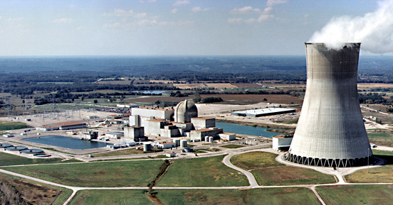
How does a nuclear power plant work?
Atoms are split to heat water to produce steam.
Steam turns the blades of a turbine.
The turbine spins a coil of wire on the shaft of a generator that turns inside a magnetic field.
Electrons flow in the coil…..That is electricity!
Animated diagram: Nuclear power station - how it works
http://www.nrc.gov/reading-rm/basic-ref/students/animated-pwr.html
Notes:
There are currently 102 nuclear power plants now operating in the United States (67 PWRs and 35 BWRs).
Highlight the url with your cursor. Right click from your mouse to select “Open Hyperlink.”
Click the caption under the diagram of the pressurized water reactor or the boiling water reactor to put the clips into motion.

Slide 9
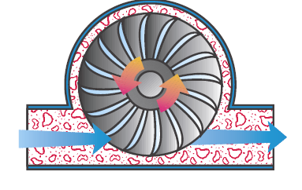
What to remember
Burn fuel or
split atoms
Heat water to make steam
Steam turns turbine
or
Turbine turns generator
Electricity is generated!
Moving water turns turbine
Notes:
Pause here for students who are visual learners to draw their own picture notes. The drawing illustrates a turbine. As steam flows over the blades of the turbine, kinetic energy turns the shaft. A coil of wire attached to the shaft of the generator turns inside a magnet. This causes
electrons to flow in the coil – and the flow of these electrons creates electricity.
Define the word generate as “to produce”. Generate is a word often used in describing the production of electricity.

Slide 10
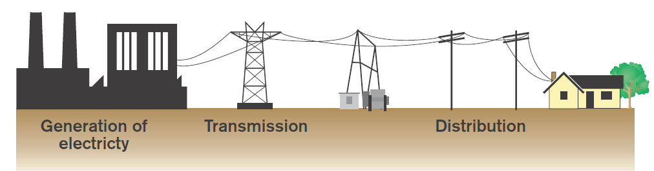
Getting electricity to customers in 3 steps
Steps in getting electricity to customers:
Generation – converting a source of energy to produce electricity
Transmission – using high voltage lines from the power plant to send electricity across long distances
Distribution– using lower voltage wires to deliver electricity to local customers.
Substation
Notes:
Transmitting electricity at high voltage reduces the fraction of energy lost to resistance.
Substations reduce the voltage to a lower level for distribution to customers.

Slide 11
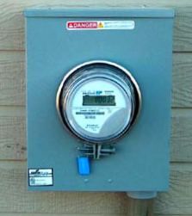
Electricity can travel hundreds of kilometers before you get it.
Electric power transmission lines (wires) move large amounts of electric power over long distances.
At the power plant, the electricity voltage is increased for transmission.
The high-voltage electricity goes through the wires of a power grid to a substation.
At a substation, electricity is reduced to lower voltages for distribution to homes, schools, and businesses.
Higher voltage goes to substations
Lower voltage goes to customers
Notes:
The electricity voltage is increased to 765,000 volts (765kV) for transmission. At a substation, electricity is reduced to 2400 volts for distribution to our homes, schools, and businesses.
Meters keep track of how much electricity travels from a utility company’s wires into homes, schools, and businesses. Ask students if they have ever noticed a meter like the one pictured here where they live.
Which machines use the most electricity in your home? Usually, number one is a heat pump or central air conditioner. Second is a tie between electric clothes dryer and water heater. If your students want more specifics, go to www.energysavers.gov/your_home/appliances/index.cfm/mytopic=10040

Slide 12
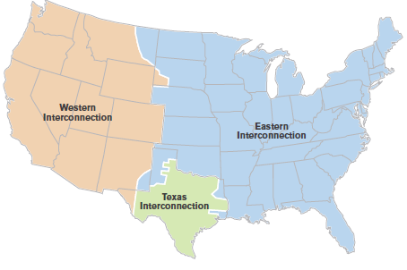
What is a power grid?
The high-voltage electric current is carried through the power grid to a substation. A power grid is a network of wires for transmitting electricity. Transmission lines have evolved into three major power grids in the 48 connected states.
Alaska and Hawaii have their own power grids.
Video clip: Smart Grid http://www.pbs.org/wgbh/nova/tech/power-grid.html
Notes:
These 48 connected states share their electric power. What advantages does this have for consumers? (steady supply even during a surge, like a heat wave)
What is the smart grid? Demand for electricity is much higher during the day than it is at night. To help balance the load, newer electric meters and appliances allow two-way communications between utility companies and customers. If an electricity need is flexible, the smart grid can dynamically schedule these uses during periods of lower demand and scale them back during periods of high demand. Smart grid technologies promise to save electricity and offer tremendous environmental benefits.
Highlight the url with your cursor. Right click from your mouse to select “Open Hyperlink.” This clip lasts about 9 minutes. (The video has a commercial that you might play before class in a separate screen tab and pause until you’re ready.)

Slide 13
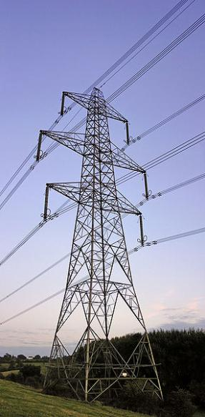
Who sells electricity?
Most people buy electricity from an electric utility company.
Utility companies sell the electricity that power plants make.
Selling electricity is more than just making it. Utilities have to
Provide and repair the power lines
Keep the supply is steady
Keep the cost affordable
Meet the government’s rules.
Notes:
Tell students that people pay for electricity every month. A bill comes in the mail to tell people how much to pay.
Ask students to think about why you have to pay for electricity. (Answer: It costs money to make it. The fuel sources cost money; workers have to be paid; and the equipment is expensive.)
Ask Students: What is a utility company? Answer: A company that sells electricity to customers.
Name the power plant(s) that serves your area. Ask if they know the source(s) used by the plant.
If your utility uses more than one source, which ones does it use for a baseload? [Baseload is the amount of power that utilities are required to make available for customers.] For example, during a drought, utilities may not be able to use hydropower. The utility may have to use a more expensive source, like solar to make the amount of electricity needed.

Slide 14
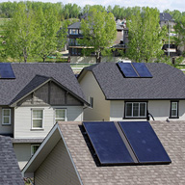
What is ahead?
Utility companies have to plan ahead.
Here are some challenges in planning.
Building new power plants and transmission lines can take 10 years or more.
Power plants cost millions or billions of dollars.
Demand for electricity goes up and down quickly with the economy.
Fuel prices change.
Conservation efforts can reduce demand.
Fossil fuels release greenhouse gases like CO₂. Reducing greenhouse gases is costly and difficult.
What do you predict for the future?
Notes:
Utility companies make decisions about how their customers’ needs will change. Ask students: What changes do you think will be true for your family? Is there only one answer to our electricity source needs?
We still use coal for 37% of our electricity.
Ask students what the black boxes on the roofs are. (Answer: Solar panels that fuel water heaters in single-family homes.)

Slide 15
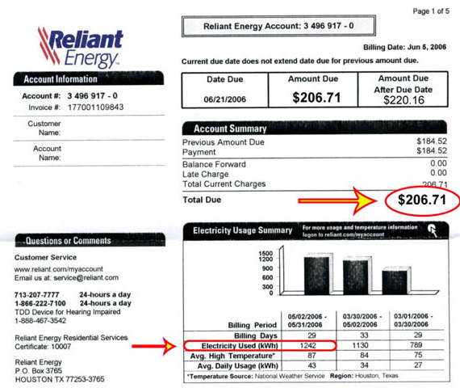
Advanced Student Assignment
When you buy gas, you pay per gallon.
When you buy electricity, you pay per kilowatt-hour.
Imagine this is your electricity bill.
How many kilowatt hours did you use last month?
How much are you paying per kilowatt hour?
Notes:
Answers:
1242 kWh
$206.71 / 1242 kWh = 0.16643. One kWh costs about 17 cents.
Remind students that hours add up quickly. The next step emphasizes that cost.

Slide 16

Advanced Student Assignment
Add the light bulb wattage in your bedroom.
Or assume that you have four 100-watt incandescent bulbs. The lights total 400 watts.
Assume you pay 15 cents per kWh.
How much does it cost if you leave your room lights on 24 hours a day for the month of October?
How much for a whole year?
What would the electricity cost be if you replaced bulbs with 23-watt fluorescent or LED bulbs?
When you go home today, add your family’s light wattage use. What is the cost of one year without turning off a light in your home?
Notes:
400 watts x 24 hours/day x 31 days/October = 297,600 total watt hours (Wh)
297,600 Wh / 1000 Wh = 297 kilowatt-hours (kWh) [Dividing by 1,000 changes usage from watt-hours to kilowatt-hours)
297 kWh x 15¢/kWh = $45/month; $540/year
Tell students the wattage of a light bulb is printed on the bulb. This exercise teams well with Lesson 2 Home Energy Audit in the Teacher’s Guide.

Slide 17
Summary: Fill in the blanks
Electricity is our most versatile form of energy. Electricity is created by the flow of tiny particles called electrons that have an electrical charge.
At power plants, electricity is produced by converting an energy source into electricity.
In the U.S., the source is usually a fossil fuel, uranium, or moving water. Solar power, wind, biomass, or geothermal can also be used.
Most U.S. power plants generate electricity by heating water to produce steam and then using steam to turn the blades of a turbine attached to a generator.
Notes:
The answers are in the sentences above. You can turn this page into an activity using your cursor to highlight the blank spaces. Use your toolbar to make the answers’ font not white.
Review these facts with students before or after a quiz.

Slide 18
Summary (continued)
There are three main steps in getting electricity to customers – generation, transmission, and distribution.
Electricity is sent through a power grid to customers.
Higher voltage goes to substations. Lower voltage goes to customers.
Companies that sell electricity are called utilities. Utilities are often regulated so that our electricity supply is steady.
Notes:
You may want to copy and paste this summary into a Word file to use as a quick quiz.

Slide 19
Vocabulary
deregulation – removing or reducing government restrictions and rules
distribution – the process of sending electricity from power plants to customers
electrical energy – the flow of tiny, negatively charged particles called electrons, usually through a wire
electric meter – a device for measuring the amount of electricity being used so that the utility knows how much to charge the customer
generation – the making of electricity
generator – a machine that makes electricity
power grid - the nation-wide linked system that moves electricity from one place to another

Slide 20
Vocabulary
regulation – a rule or directive made and maintained by an authority; the status of being required to follow rules made and maintained by an authority
regulatory agency – a public authority or government agency responsible for supervising or exercising authority over some area of human activity
smart grid – a name given to the use of computer intelligence applied to the transmission and distribution of electricity
steam – water in vapor form; invisible gas made when water is heated to the boiling point
substation – a part of an electrical generation, transmission, and distribution system where voltage is transformed from high to low or the reverse
transmission – the sending or moving of electricity

Slide 21
Vocabulary
turbine - a wheel with many blades that are spun and connected to a generator to make electricity
utility - a company that provides a public service or product, such as electricity, water, or telephone
voltage – the difference in electrical charge between two points

Slide 22

EXTENSION LESSON Most towns and cities have only one.
Most towns and cities have only one electric utility company.
When more than one business sells what you want to buy, we we call it competition.
Here’s an example.
You’ve saved money for a new skateboard. Your town has only one shop that sells the skateboard you want.
What if another shop opened? Would you buy from them if they were cheaper?
Would you check online for a better price?
Competition might change where you spend money.

Slide 23
EXTENSION LESSON (cont’d) Why do most towns have only one utility company?
Although competition is generally good for consumers, many State governments grant one company rights to provide electric service. This is called a monopoly.
Why only one?
The cost of providing electricity to customers in remote locations is expensive.
Utility companies are granted regulated monopolies in exchange for agreeing to serve all customers instead of just the most profitable ones.
Is your State regulated or deregulated?
Check it out at http://www.eia.doe.gov/cneaf/electricity/page/restructuring/restructure_elect.html
Notes:
Deregulating means that a monopoly system of electric utilities has been replaced with competing sellers. Is this always a good thing? The answer is more complicated than it seems. Here’s more information:
http://www.newsbatch.com/electric.htm
http://www.usatoday.com/money/industries/energy/2007-08-09-power-prices_N.htm

Slide 24

EXTENSION LESSON (cont’d) Why does government get involved?
Most States are regulated. They do not have competitive utilities. So, State governments have rules for utilities. The rules are called regulations.
Regulations control
How much utilities can charge
What services they have to provide
How much profit they can make.
Some states are deregulating utilities. But electricity is so necessary that they still approve the price that can be charged.
Notes:
Ask students: Why do you think the electric industry being deregulated in some states?
Some studies comparing regulated and unregulated industries have showed the advantages of competition. If electric utilities compete with one another for customers, there is more incentive to develop the technology that will increase efficiency and thus lower prices. Such an atmosphere can produce benefits for customers, the environment, and the industry as a whole.

